Slide 1
Breast Cancer Detection with Machine Learning
By Sanjana Kuchipudi

Slide 2
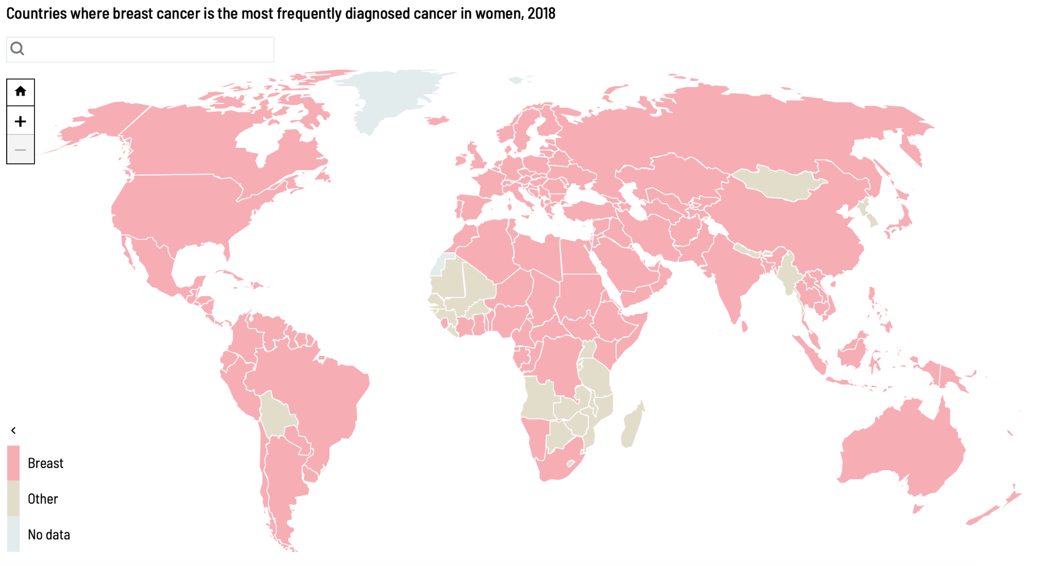

Why Breast Cancer Detection?
Breast cancer is one of the most common causes of death in women worldwide.
“Women whose breast cancer is detected at an early stage have a 93 percent or higher survival rate in the first five years.”- Carol milgard breast center
It is critical to find a method of early detection
Breast cancer detection is challenging because it can manifest in many ways.
Using machine learning can get rid of the human error and save more lives.
https://www.ncbi.nlm.nih.gov/pmc/articles/PMC6906728/
https://canceratlas.cancer.org/the-burden/breast-cancer/
https://www.carolmilgardbreastcenter.org/early-detection

Slide 3
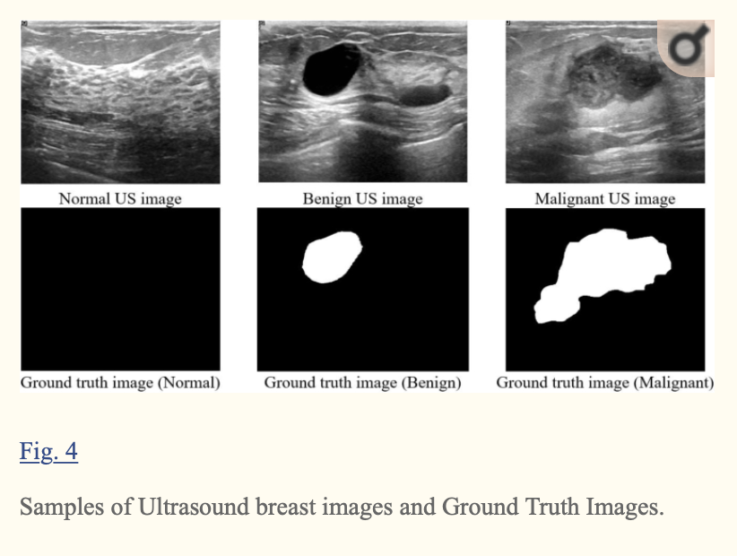
Key Terms
Normal = healthy and nothing abnormal
Benign = unusual but not cancerous growths
Malignant = term breast cancer refers to a malignant (cancerous) tumors.
Ground truth image = target of machine learning, the abnormal or cancerous growth
The ground truth is done using matlab (in the study)
and it's an example of a mask image for each kind, normal, benign or malignant.
The result should be a machine learning model that is able to take an image of a breast ultrasound and then classify and detect breast cancer.

Slide 4
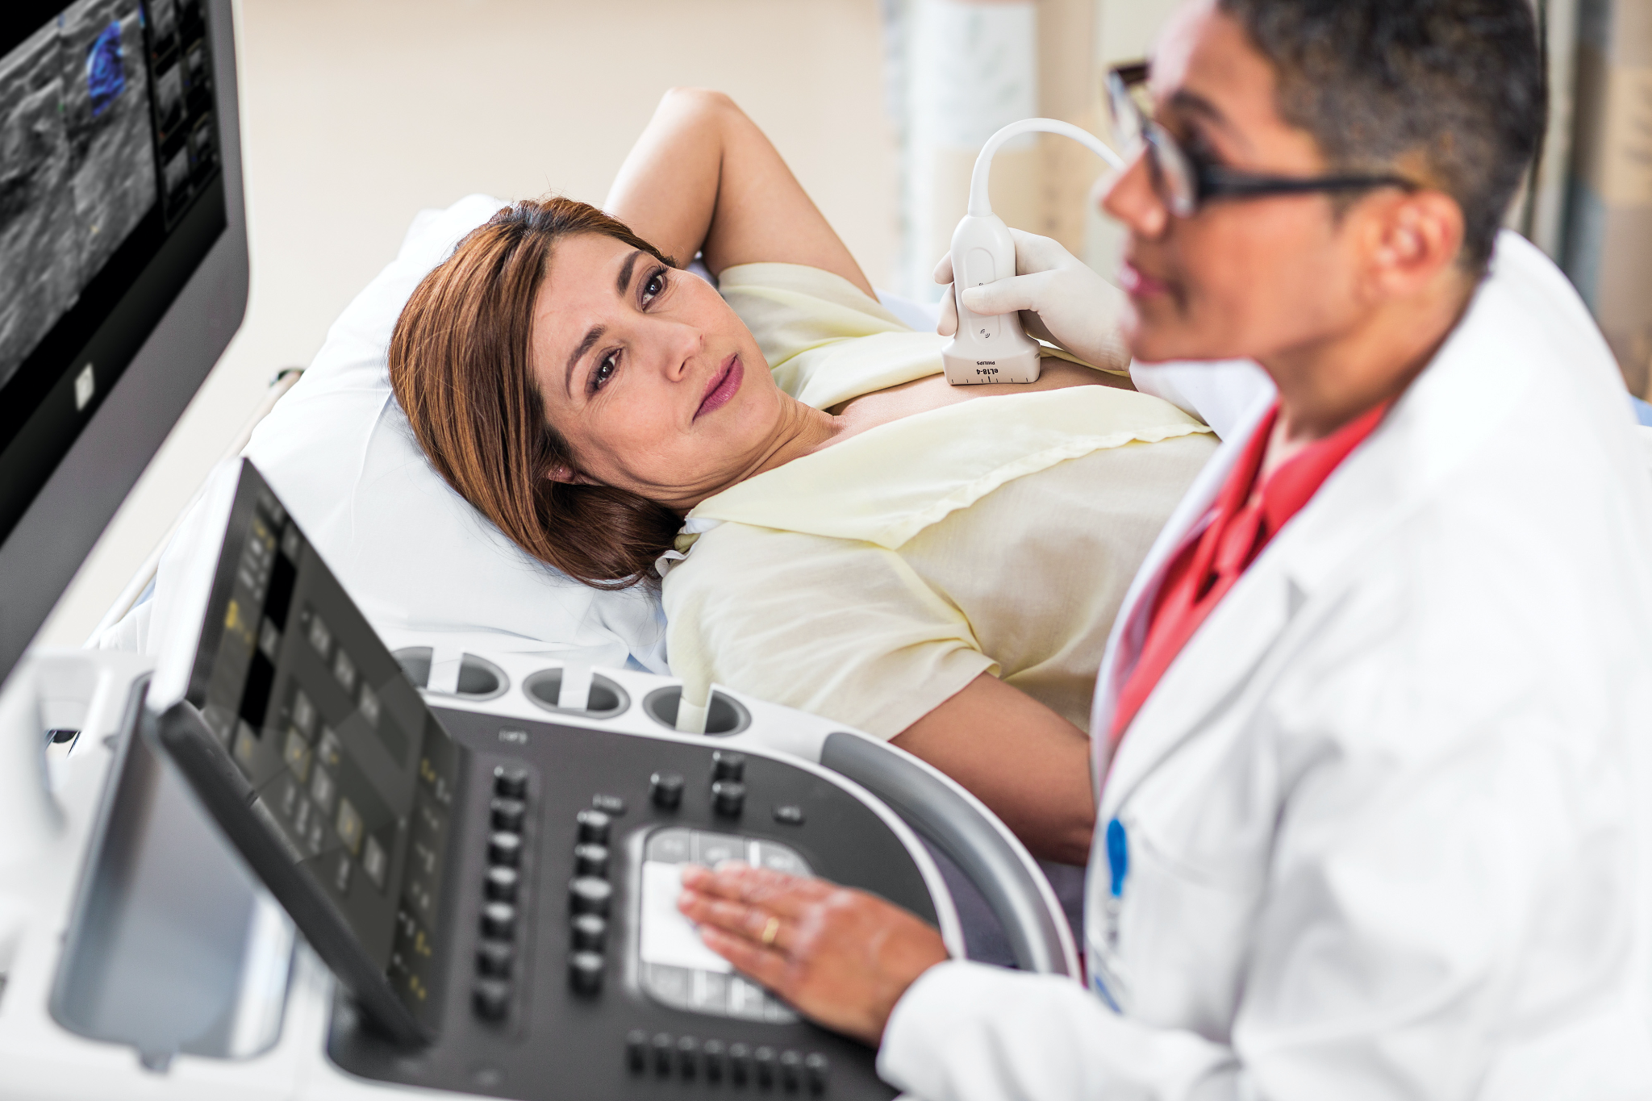
Data collection
Data collection from 25 to 75 year olds women from the Baheya hospital from Cairo.
There are 780 images in the dataset that are about the size 500 multiplied by 500 pixels in PNG format.
Data set can be used to train machine learning models to help detect breast cancer.

Slide 5
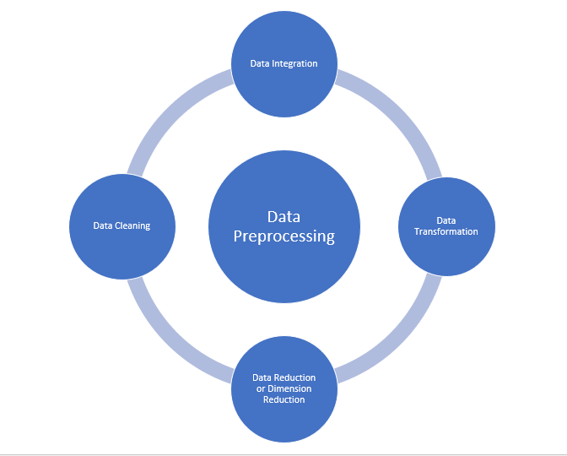
Preprocessing
Duplicate images removed and fix the errors with the classification.
Type of image changed from DICOM images to PNG using a DICON converter
Images cropped to remove unnecessary surrounding details
Vetting process: checked by specialists to ensure its correct classification
‘Fuzzy enhancement step’ to reduce blurriness.

Slide 6
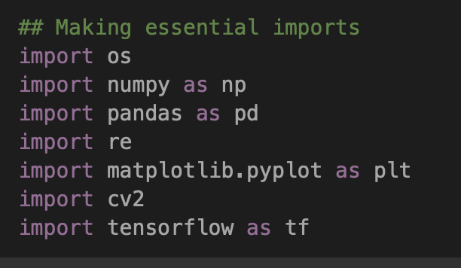
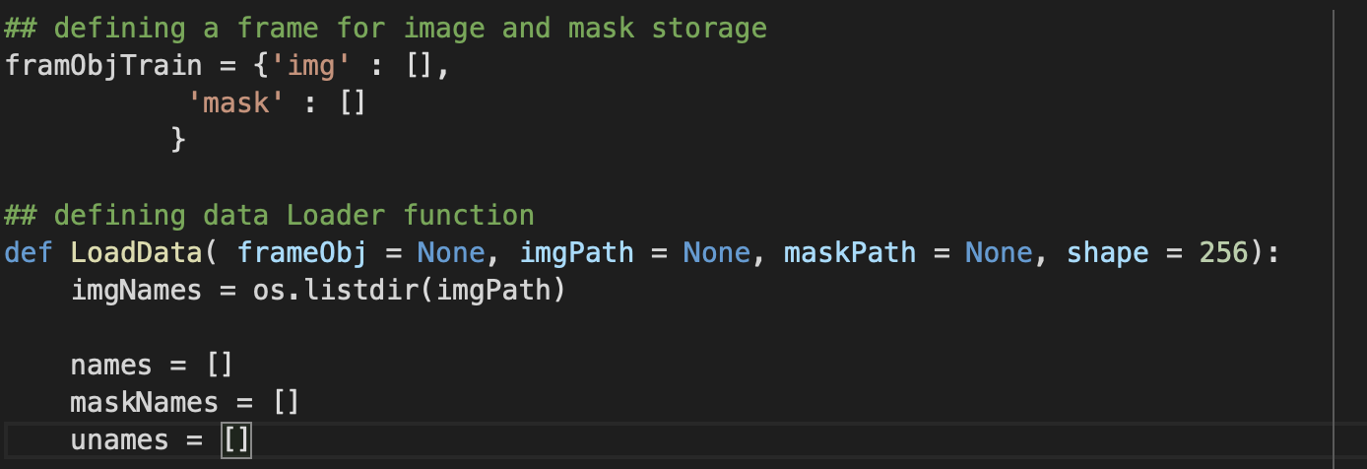
Segmentation model steps
Making the necessary imports
Loading the data in
Defining the data loader function
Data loader function enables high volume imports
Data loading is an important component of machine learning when working with large datasets.

Slide 7
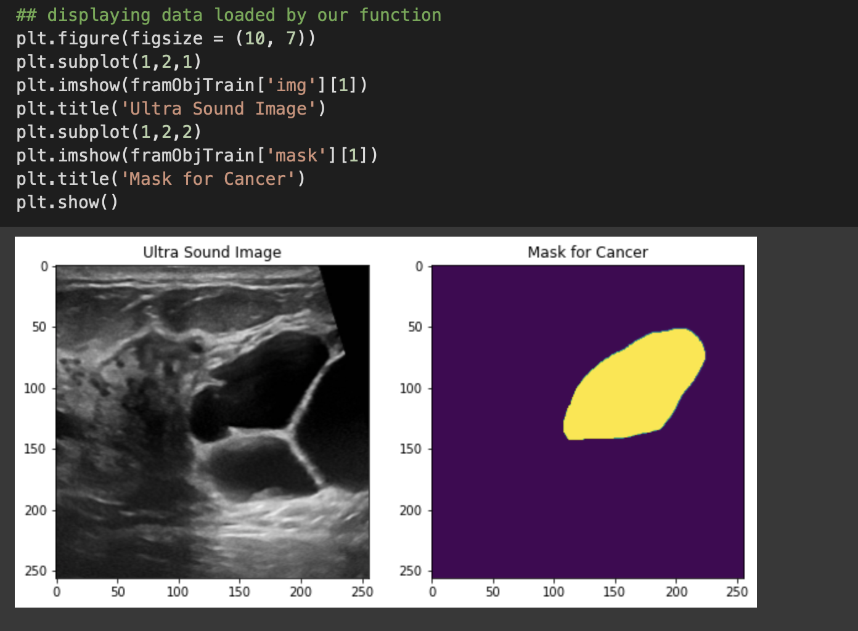
cont.
Displaying the data that has been loaded in..
Customizing the figure size and creating a title.

Slide 8
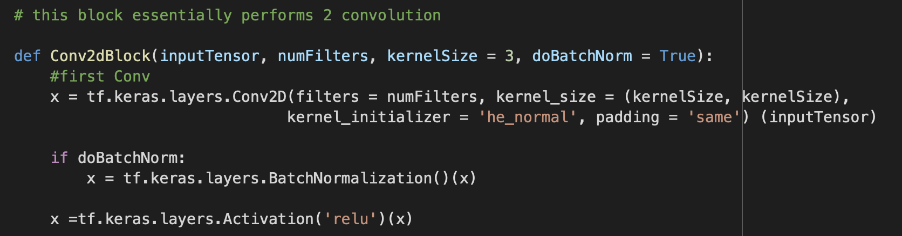
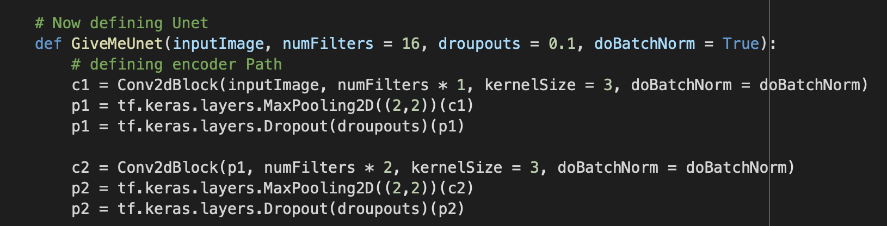
Steps cont. U-net
Model definition
Unet and using layers
U-net is a neutral network used for image segmentation for biomedical sciences.
Conv2d are used for high accuracy in image recognition
Kernel is used in image processing. In this case it is used for edge detection.
U-net is a neutral network used for image segmentation for biomedical sciences.
The goal is to be given an image and then predict a segmentation mask that highlights the breast growth (cancerous or not)

Slide 9
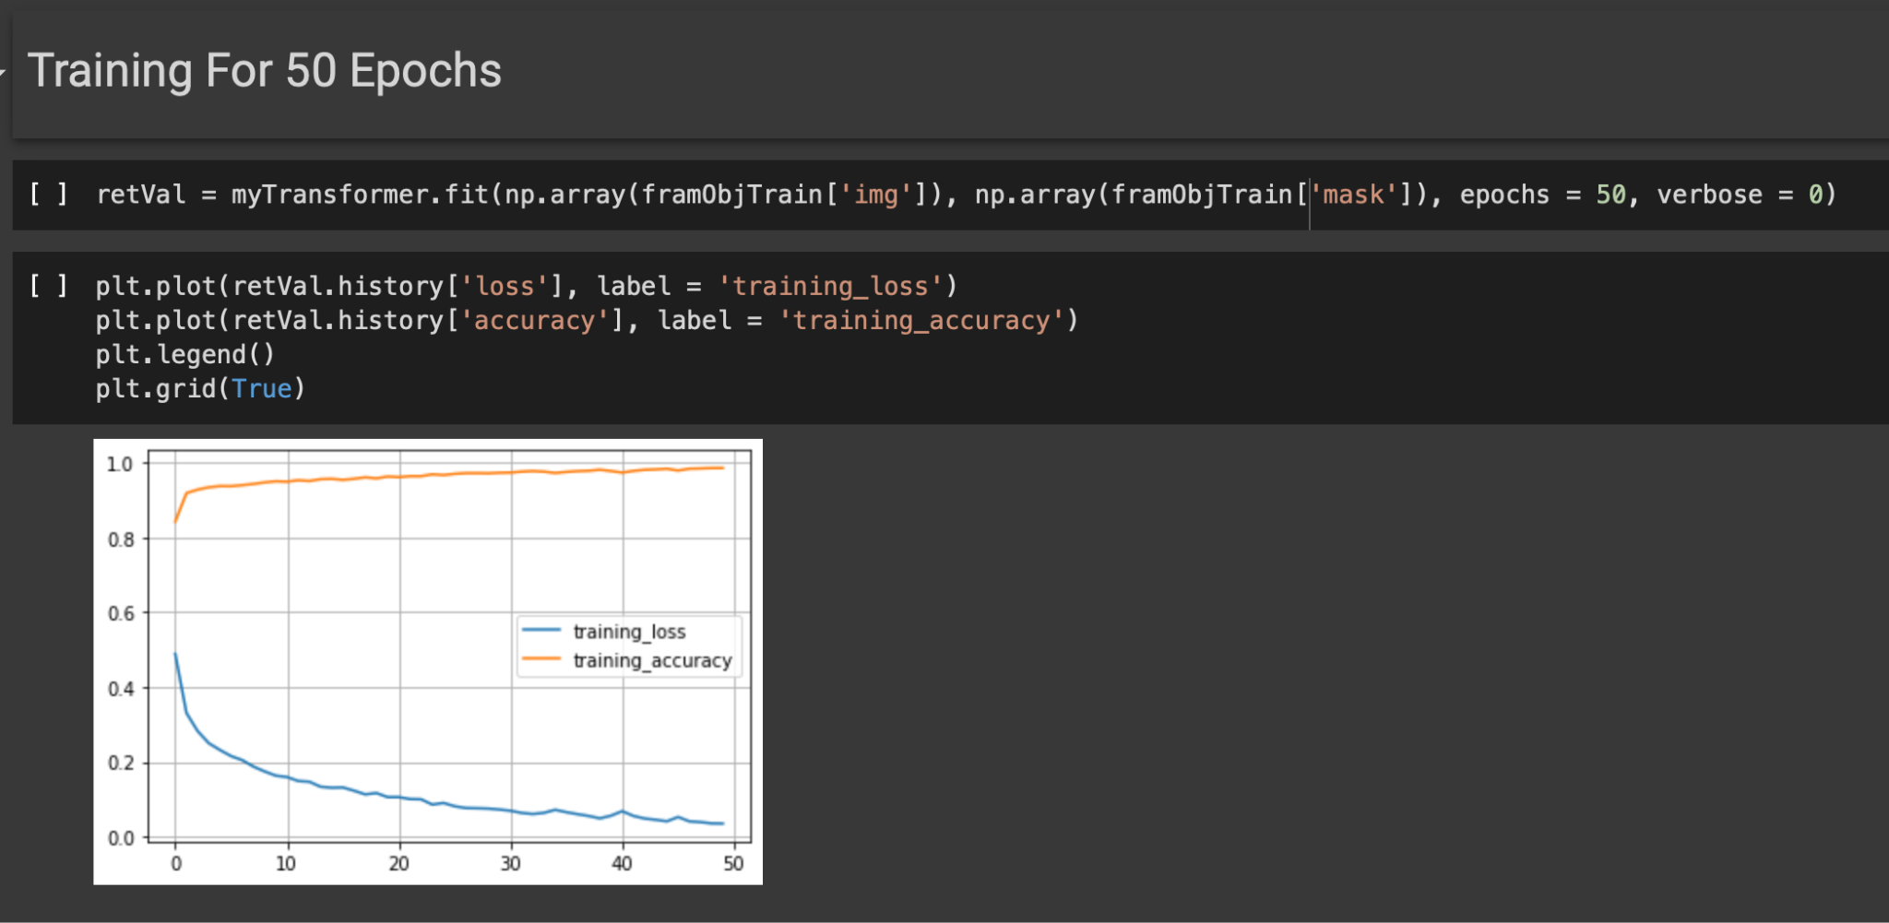
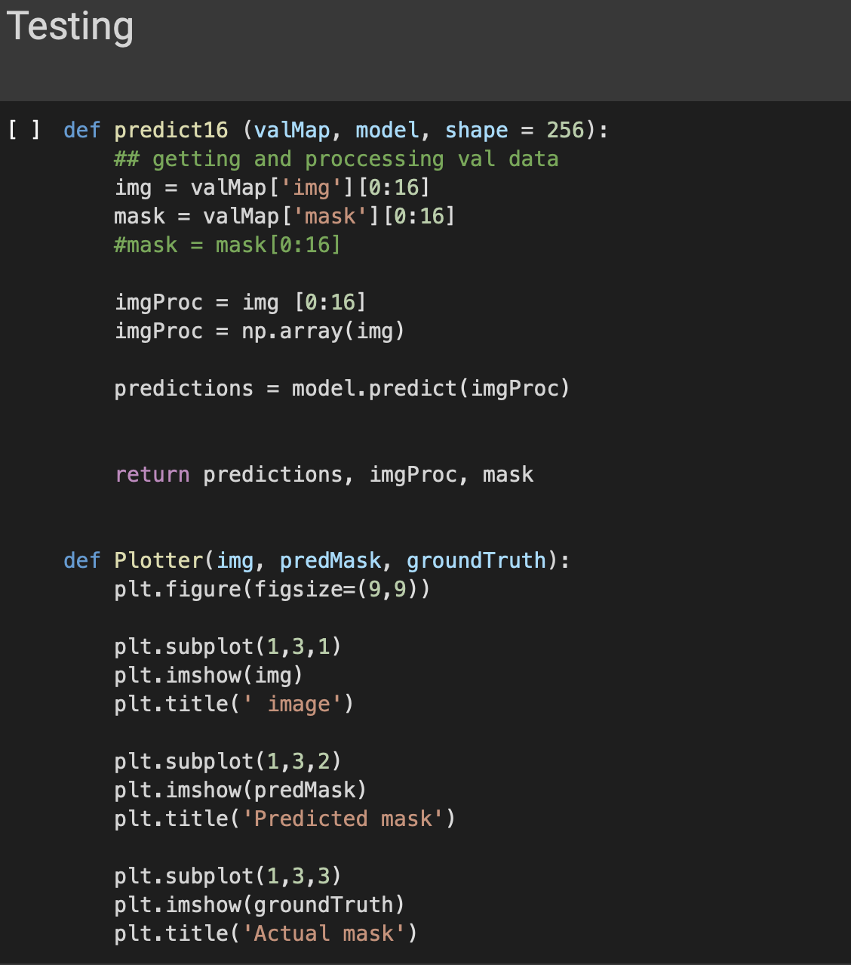
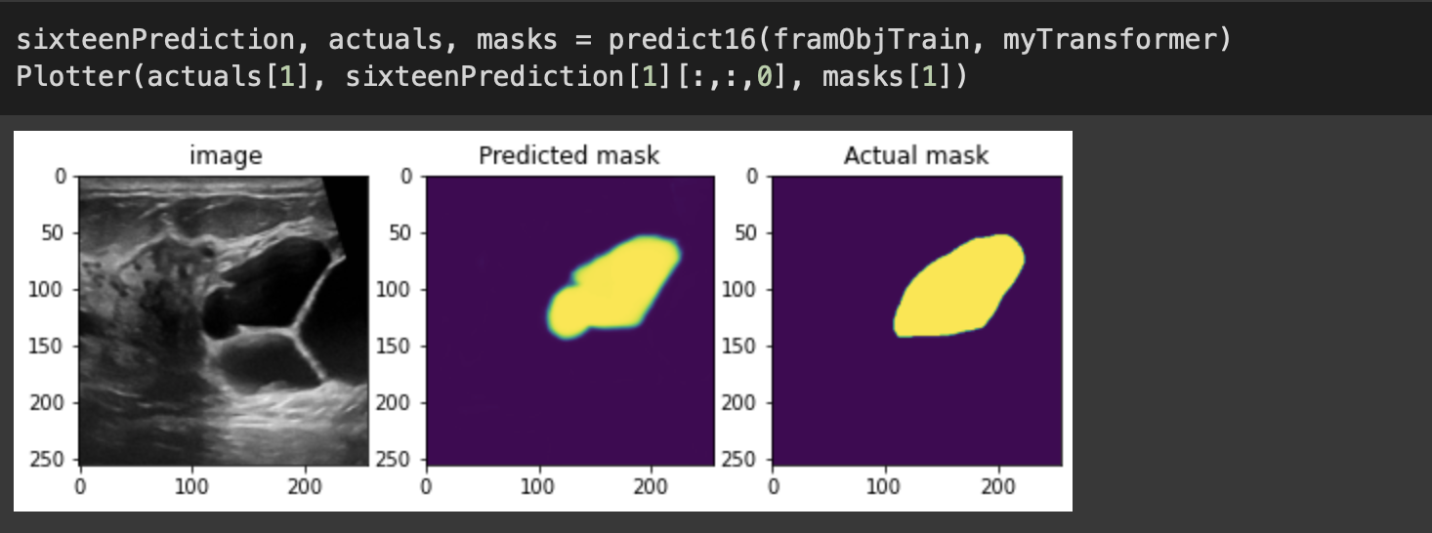
Training and testing
Training 50 epochs- entire dataset passed forward and back through the neutral network 50 times.
Testing and results:
Testing 0 to 16 and showing the predicted mask

Slide 10
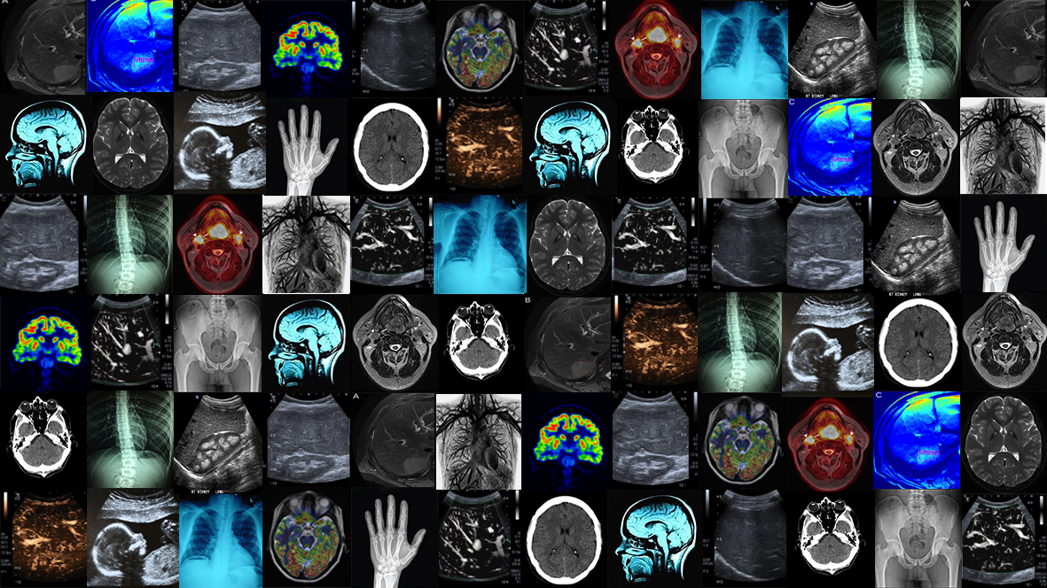
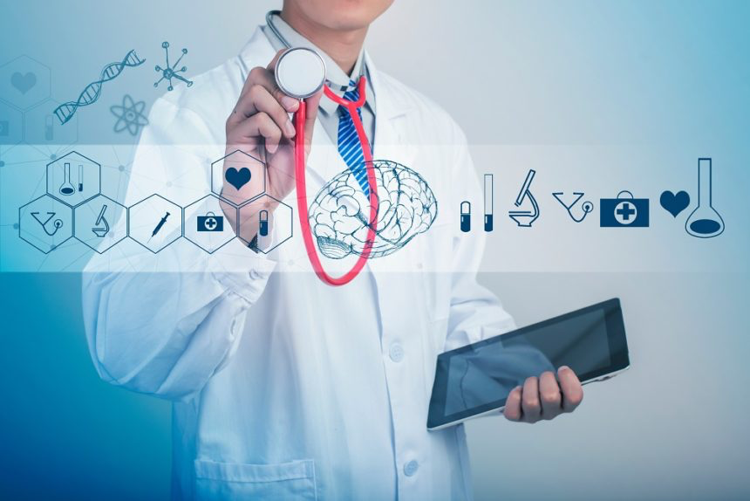
Future Applications
This method of combining images and their classification and using that to identify a new patient's diagnosis can be universally applied in different areas, not just breast cancer.

